Slide 1



Asymmetric key Cryptography
Ms. Swati Mali
B-215
swatimali@gmail.com
Assistant Professor, Department of Computer Engineering
K. J. Somaiya College of Engineering
Somaiya Vidyavihar University

Slide 2


Outline
Symmetric vs Asymmetric key cryptography
Stream ciphers vs block ciphers
Public key cryptography
RSA
Elliptic curve cryptography
Public Key infrastructure (PKI)

Slide 3
Symmetric Key cryptography
Uses same key in encryption and decryption process
The encryption and decryption processes are inverse operations of each other
Every user pair has to maintain the separate symmetric encryption key
Both users have to maintain secrecy of the key
Can be used to authenticate only each other, cannot be used to authenticate themselves to everybody else
Classical symmetric key ciphers: Caesar Cipher, Playfair cipher, columnar cipher, railfence cipher etc
Classical block ciphers :ECB, OFB, CFB, CBC
Modern block ciphers : DES, AES

Slide 4
Symmetric Key cryptography
A group of 100 users needs how many symmetric keys in total?

Slide 5
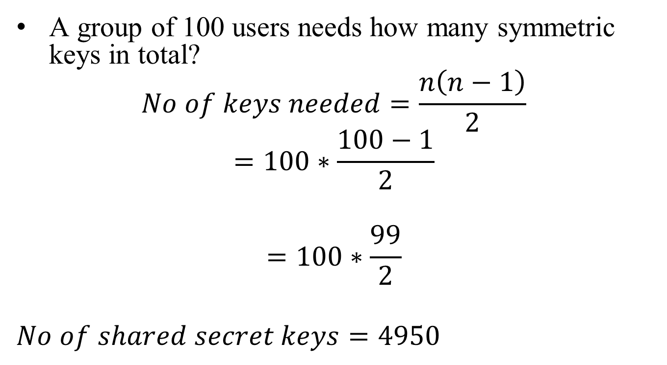
Symmetric Key cryptography
A group of 100 users needs how many symmetric keys in total?
$$No of keys needed=\frac{n\left(n−1\right)}{2}$$
$$=100∗\frac{100−1}{2}$$
$$=100∗\frac{99}{2}$$
$$No of shared secret keys=4950$$

Slide 6
Asymmetric Key cryptography
Uses different keys in encryption and decryption process
The encryption and decryption processes might be inverse operations of each other
Every user has to maintain a pair of keys: public key and private key
Only the private keys are kept secret, public keys can be announced to world
Can be used to authenticate themselves to everybody else
Typically follows stream ciphers
Examples: RSA, ECC

Slide 7
Asymmetric Key cryptography
A group of 100 users needs how many asymmetric keys in total?

Slide 8
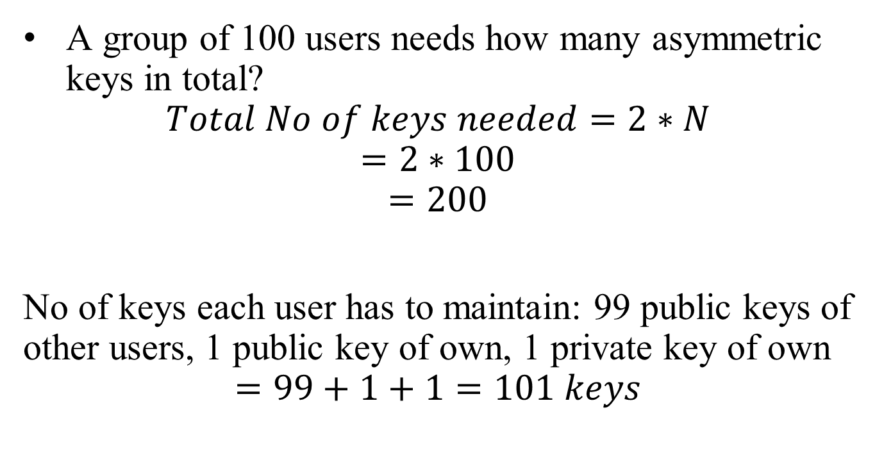
Symmetric Key cryptography
A group of 100 users needs how many asymmetric keys in total?
$$Total No of keys needed=2∗N$$
$$=2∗100$$
$$=200$$
No of keys each user has to maintain: 99 public keys of other users, 1 public key of own, 1 private key of own
$$=99+1+1=101 keys$$

Slide 9
Symmetric vs Asymmetric key differences
Speed: Symmetric encryption is generally faster than asymmetric
Data Size: Symmetric encryption is block cipher while Asymmetric is stream cipher
Key distribution: In symmetric encryption, secure key distribution is crucial, as the same key is used for both encryption and decryption. Asymmetric encryption simplifies key distribution, as only the public key needs to be shared.
Key usage: Symmetric encryption uses a single shared key for both encryption and decryption, while asymmetric encryption employs a pair of keys: a public key for encryption and a private key for decryption.
Use cases: Symmetric encryption is ideal for bulk data encryption and secure communication within closed systems, whereas asymmetric encryption is often used for secure key exchanges, digital signatures, and authentication in open systems.
Ref: https://preyproject.com/blog/types-of-encryption-symmetric-or-asymmetric-rsa-or-aes#:~:text=Asymmetric%20and%20symmetric%20encryption%20are,a%20private%20key%20for%20decryption.

Slide 10
Symmetric vs Asymmetric key differences
Security: Asymmetric encryption is considered more secure due to the use of two separate keys, making it harder for attackers to compromise the system. However, symmetric encryption can still provide strong security when implemented correctly with strong key management practices.
Scalability: With a pair of keys, it is not difficult to communicate with multiple parties using Asymmetric key and that’s how it is more scalable in large networks. With symmetric key, key management is a major issue
Resource Utilization: Symmetric key encryption works on low usage of resources. Asymmetric encryption requires high consumption of resources.
Key Lengths:128 or 256-bit key size for symmetric key cryptography while RSA uses 2048-bit or higher key size.
Ref: https://preyproject.com/blog/types-of-encryption-symmetric-or-asymmetric-rsa-or-aes#:~:text=Asymmetric%20and%20symmetric%20encryption%20are,a%20private%20key%20for%20decryption.

Slide 11
Public Key Cryptosystems
Public-key/two-key/asymmetric cryptography involves the use of two keys:–
a public key, which may be known by anybody, and can be used to encrypt messages, and verify signatures
A related private-key, known only to the recipient, used to decrypt messages, and sign(create) signatures
Is asymmetric because–key used for encryption cannot be used for decryption and vice a versa
Asymmetric algorithms rely on one key for encryption and a different but related key for decryption

Slide 12
Some terms
A message X in plaintext can be considered as X ==[X1, X2,… XM]
The M elements of X are letters in some finite alphabet
The message is sent by user A and is intended for destination user B
B generates a related pair of keys a public key, PU_{b} and a private key, PR_{b}
PR_{b} is known only to B, whereas PU_{b} is publicly available and therefore accessible by A
With the message X and the encryption key PU_{b} as input, A forms the ciphertext
Y= [Y1, Y2, ..YN]
Y=E(Pu_{b,}X)
The intended receiver, in possession of the matching private key, is able to invert the transformation
X = D(PR_{b} ,Y)

Slide 13
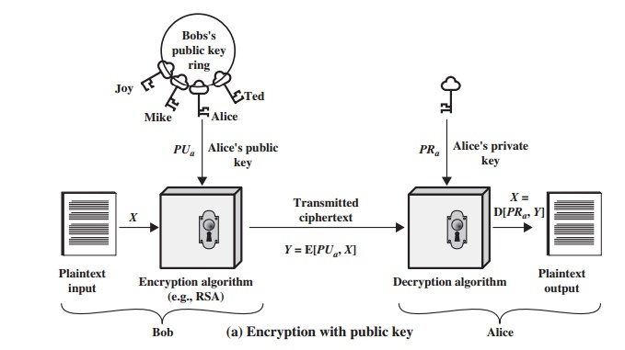
Encryption with Public key

Slide 14
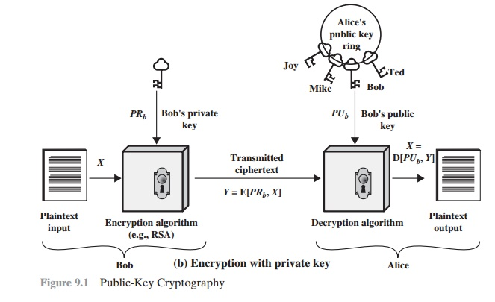
Encryption with Private key

Slide 15
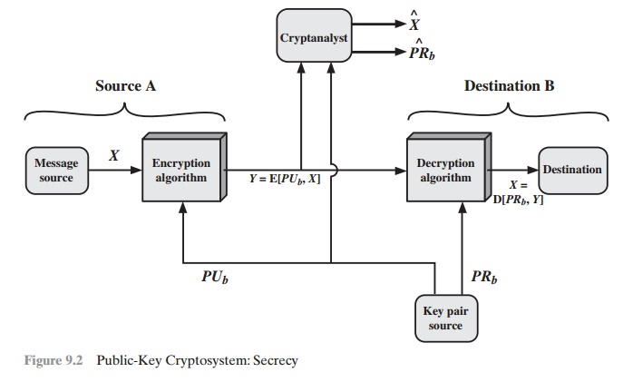
Confidentiality with Public key cryptography

Slide 16
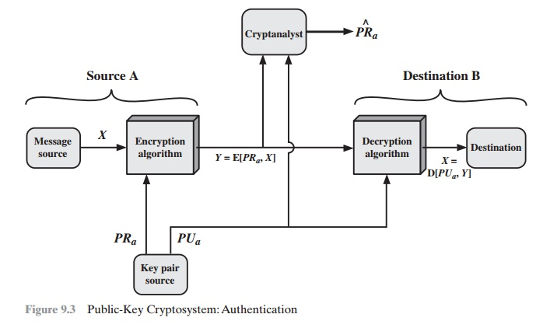
Authentication with Public key cryptography

Slide 17
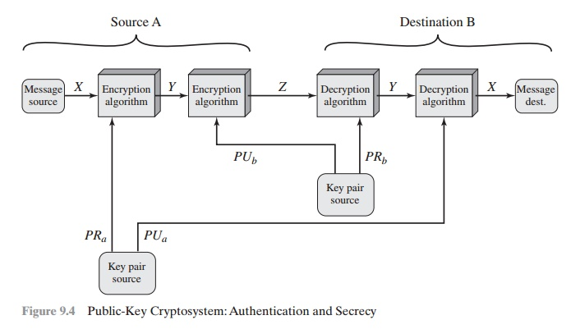
Combining Authentication and confidentiality

Slide 18
Requirements of Public Key Cryptography
It is computationally easy for a party B to generate a key pair (public key PU_{b} private key PR_{b})
It is computationally easy for a sender A, knowing the public key and the message to be encrypted, M, to generate the corresponding ciphertext
C = E(Pu_{b}, M)
It is computationally easy for the receiver B to decrypt the resulting ciphertext using the private key to recover the original message
M= D( PR_{b},C)= D[ PR_{b,}E( PU_{b},M)]

Slide 19
Requirements of Public Key Cryptography
Algorithm must fulfill:
It is computationally infeasible for an adversary, knowing the public key, PU_{b} to determine the private key PR_{b}
It is computationally infeasible for an adversary, knowing the public key, PU_{b} and a ciphertext C, to recover the original message M.

Slide 20
Public key cryptography
The two keys can be applied in either order
M= D[Pu_{b}, E( PR_{b},M)]= D[ PR_{b}, E(Pu_{b},M)]

Slide 21
RSA
"RSA" comes from the surnames of Ron Rivest, Adi Shamir and Leonard Adleman,
RSAs publicly described the algorithm in 1977 at MIT, first published in 1978[RIVE78]
Stream cipher system

Slide 22
RSA
The RSA algorithm involves four steps:
key generation,
key distribution,
encryption,
and decryption.
RSA uses modular exponentiation for encryption/decryption
To attack it, Eve needs to calculate ^{e}√c mod n.

Slide 23
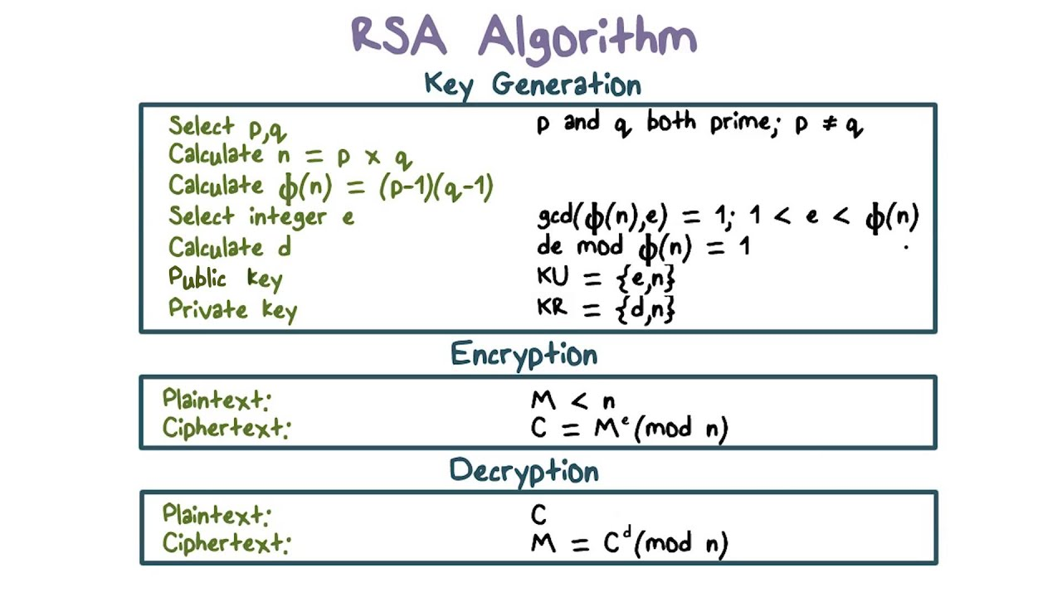

Slide 24
Example 1
P=3, q=5 , thus n = p*q =15
Euler’s Totient function to compute no of numbers co-prime with n:
Φ (n) = (p-1)*(q-1) = 2 * 4 = 8
Choose e, such that Gcd (e, Φ ( n)) = 1 and , 1< e< Φ (n)
Thus e could be any value from the set: ={3,5,7} as
GCD(e, Φ ( n)) is 1 and 1<e<8
Let e = 3
Compute d as: d*e mod Φ (n) = 1
d * 3 mod 8 = 1 (Use extended Euclidean’s method to compute multiplicative inverse)
So, d = 3
Public key = ( e,n ) = (3,15)
Private key = ( d,n ) = (3,15)
Let M= 4
C= Me mod n = 4³ mod 15= 4
M=C^{d} mod n = 4³ mod 15= 4

Slide 25
Example 2
P=11, q=3, thus n = p*q =33
•(n) = (p-1)*(q-1) = 10*2 = 20
Choose e such that Gcd(e, Φ(n)) = 1 and 1<e<Φ(n)
So e = {3,7,9,11,13,17,19}
Let e= 3
Compute d such that: d* e mod Φ(n) = 1
d * 3 mod 20 = 1
So, d = 7
Public key = (e,n) = (3,33)
Private key = (d,n) = (7,33)
Let M= 7
C=Memodn=7³mod 33=13
M=C^{d}modn=13⁷mod 33=7

Slide 26
Applications of RSA
RSA is a versatile encryption and authentication algorithm with a wide range of applications in securing :
Digital communication,
Data security , and
Digital transactions.
Its strength lies in its ability to provide secure encryption and digital signatures while allowing for public key distribution, making it a cornerstone of modern cryptography.
Sign: Encrypt with private key
Verify: Decrypt with associated public key

Slide 27
Applications of RSA
Secure Data Transmission: RSA is commonly used for securing data transmission over insecure networks, such as the internet. It's employed in protocols like SSL/TLS for securing web traffic, SSH for secure remote access, and S/MIME for secure email communication.
Digital Signatures: RSA is used to create digital signatures, which verify the authenticity and integrity of digital documents or messages. Digital signatures are vital for ensuring that the sender of a message is who they claim to be and that the message has not been tampered with.
Secure Key Exchange: RSA can be used to securely exchange encryption keys between two parties. For example, it's used in the Diffie-Hellman key exchange protocol to establish secure communication channels between parties.

Slide 28
Applications of RSA
Secure Email: RSA encryption is used in email encryption schemes like PGP (Pretty Good Privacy) and S/MIME to secure the content of emails, ensuring that only the intended recipient can decrypt and read the message.
Secure File Transfer: RSA can be used to secure file transfers, ensuring that files are encrypted during transmission and can only be decrypted by authorized recipients.
Digital Certificates: RSA is a fundamental component of digital certificates, which are used to verify the identity of websites, organizations, or individuals on the internet. Certificate Authorities (CAs) use RSA to create and sign digital certificates.

Slide 29
Applications of RSA
Secure Login and Authentication: RSA is used in secure login mechanisms, such as two-factor authentication (2FA) and Secure Shell (SSH) logins. It helps ensure that only authorized users can access systems or accounts.
Secure E-commerce Transactions: RSA plays a crucial role in securing online transactions, including credit card transactions and online banking. It protects sensitive financial information during transmission.
VPN Encryption: Virtual Private Networks (VPNs) use RSA for encryption to establish secure connections over the internet. RSA encryption ensures that data transmitted between the user and the VPN server remains confidential.

Slide 30
Applications of RSA
Data Integrity Checking: RSA signatures can be used to verify the integrity of software updates and downloads. Users can be confident that the software has not been tampered with during the download process.
Secure Chat and Messaging Apps: Many secure chat and messaging apps use RSA encryption to secure conversations and messages, ensuring that only the intended recipients can read the messages.
Secure IoT Communication: RSA can be used to secure communication in the Internet of Things (IoT) by encrypting data transmitted between IoT devices and cloud servers, protecting sensitive information and device control commands.
Secure Cloud Storage: RSA encryption can be employed to protect data stored in the cloud, ensuring that only authorized users can access and decrypt it.

Slide 31
Advantages of RSA
Security: highly secure when used with sufficiently long key lengths. Breaking RSA is a computationally intensive and becomes increasingly difficult as the key length grows.
Public/Private Key Pair: Dual-key system in RSA eliminates the need for both parties to share a secret key beforehand
Digital Signatures: used in secure communication and document verification.
Key Exchange: To securely exchange secret keys for symmetric encryption algorithms such as SSL/TLS.
Mathematical Soundness: RSA is based on the mathematical difficulty of factoring large semiprime numbers, which is believed to be a hard problem. Its security is rooted in well-established mathematical principles.
Standardization: RSA has been widely standardized and is supported by many cryptographic libraries and software implementations, making it easy to integrate into various applications.

Slide 32
Disadvantages of RSA
Key Length: key lengths can impact performance and increase computational overhead. Longer key lengths also require more storage for keys and certificates.
Computational Intensity: encryption and decryption operations are computationally intensive, especially with longer key lengths. This slows down processing, making it less suitable for resource-constrained devices.
Vulnerability to Quantum Computing: The security of RSA relies on the difficulty of factoring large numbers, which could be broken by quantum computers As quantum computing technology advances, RSA's security may be compromised.
Key Management: RSA key management can be challenging, especially in large-scale systems. Safeguarding private keys and ensuring their integrity is critical. Loss or compromise of a private key can have severe security consequences.

Slide 33
Disadvantages of RSA
Performance Overhead: The computational overhead of RSA encryption and decryption can impact the performance of systems, particularly in high-throughput applications like web servers.
Solution : Use hybrid encryption schemes (using RSA for key exchange and symmetric cryptography for data encryption) are often employed.
Lack of Forward Secrecy: RSA does not provide forward secrecy, which means that if an attacker obtains a private key, they can decrypt all past and future communications encrypted with that key. This is a limitation in situations where forward secrecy is desired.
Key Length vs. Security: As computing power advances, key lengths required to maintain security may need to be increased. This can be a challenge because longer key lengths increase computational demands and may not be supported by older hardware and software.

Slide 34
Summary: Attacks on RSA
Brute Force Attack:
attacker attempts every possible private key until they find the one that successfully decrypts a message.
not practical against RSA when long key lengths
Factorization Attack:
based on the difficulty of factoring the product of two large prime numbers.
Attack aims to find the prime factors of the modulus (n) to compute the private key.
Advanced algorithms like Pollard's rho algorithm and the General Number Field Sieve (GNFS) have been developed to factor large numbers efficiently.
The security of RSA relies on the difficulty of this factorization problem.
Timing Attacks:
Timing attacks involve measuring the time it takes for an RSA operation to execute.
By analyzing the timing variations, an attacker can gain information about the private key, particularly in scenarios where RSA operations take different amounts of time based on the input data.

Slide 35
Summary:Attacks on RSA
Chosen Plaintext Attack:
attacker can choose specific plaintexts and observe the corresponding ciphertexts produced by an RSA
With enough pairs of plaintext/ciphertext, an attacker may be able to deduce information about the private key.
Ciphertext-Only Attack:
attacker has access only to encrypted messages without knowledge of the corresponding plaintexts.
This is a challenging scenario, but in some cases, it may be possible to gain partial information about the plaintext or the private key.

Slide 36
Summary:Attacks on RSA
Common Modulus Attack:
attacker has access to two different ciphertexts encrypted with the same RSA modulus but different public exponents.
By exploiting mathematical relationships between these ciphertexts, an attacker may recover the plaintext.
Quantum Computing Attacks:
Quantum computers, if developed sufficiently, could potentially factor large numbers efficiently using algorithms e.g. Shor's algorithm.
This would render RSA encryption vulnerable, highlighting the need for post-quantum cryptographic solutions.

Slide 37
Details- RSA attacks with examples

Slide 38
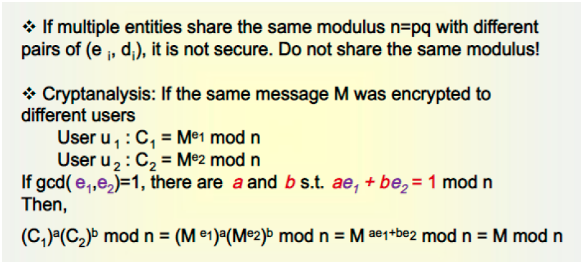
Common Modulus Attack

Slide 39
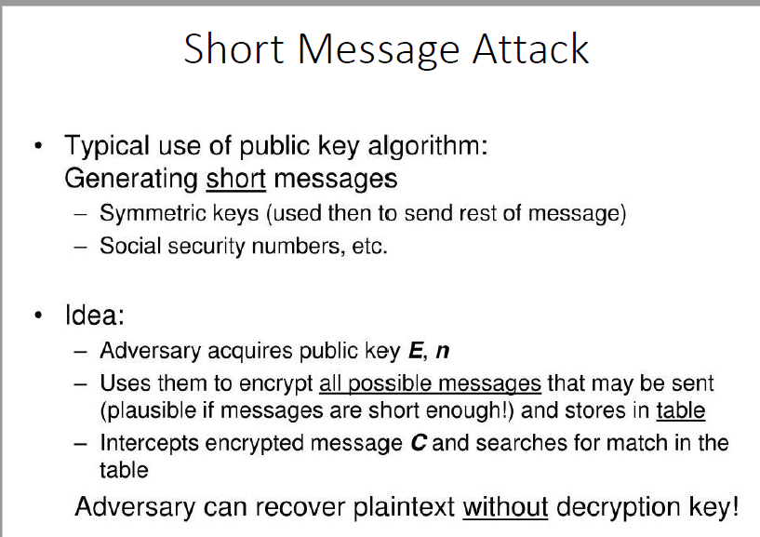

Slide 40
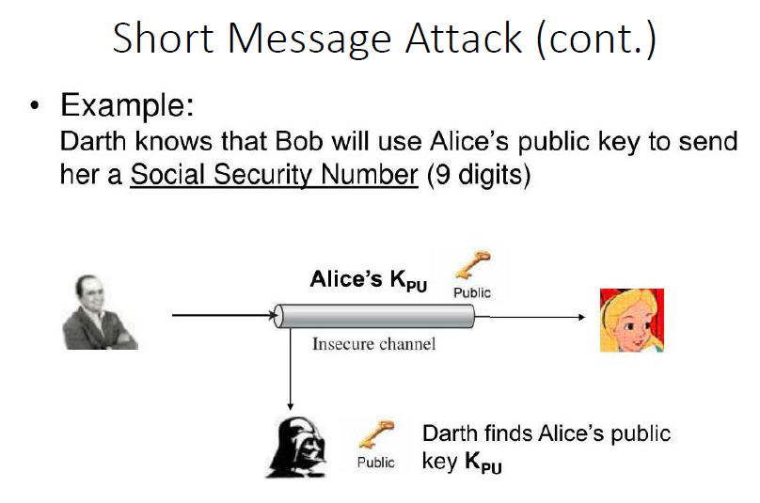

Slide 41
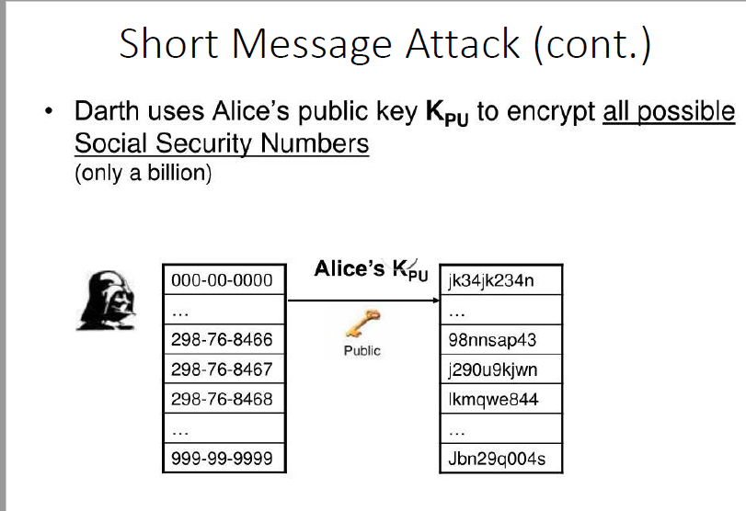

Slide 42
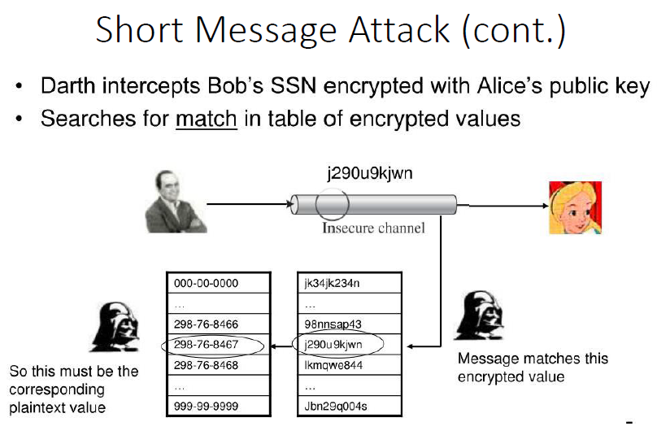

Slide 43
RSA Cryptanalysis: Timing Attack (Theoretical)
Timing attacks measure the time taken to perform cryptographic operations.
Let's assume you're performing RSA encryption with an insecure implementation that leaks information through timing variations.
You collect timing data for multiple encryptions of the same plaintext.
Encryption 1: 5 ms
Encryption 2: 4 ms
Encryption 3: 6 ms
From the timing data, one might observe that the encryption operation took longer for Encryption 3.
This could indicate that the plaintext had a particular property or structure.
Over time, one might gather enough information to make educated guesses about the private key.
In practice, mitigating timing attacks requires implementing secure cryptographic libraries and protecting against side-channel attacks.

Slide 44
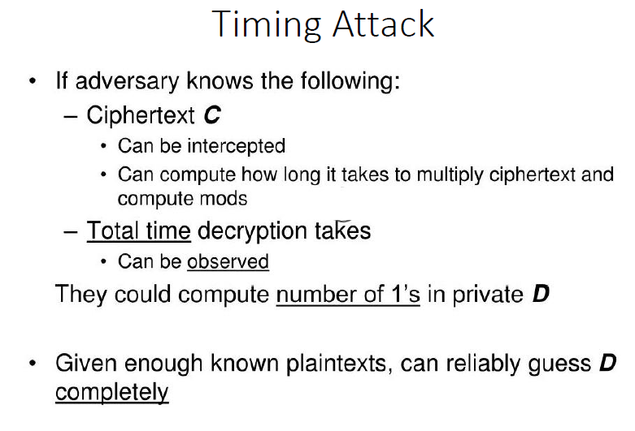

Slide 45
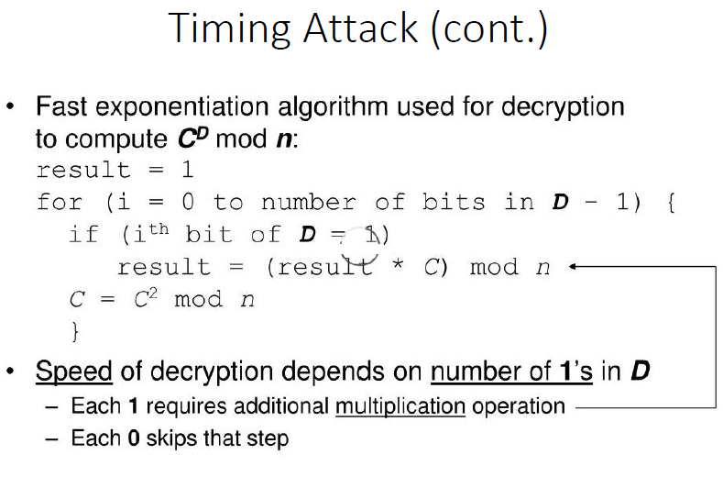

Slide 46
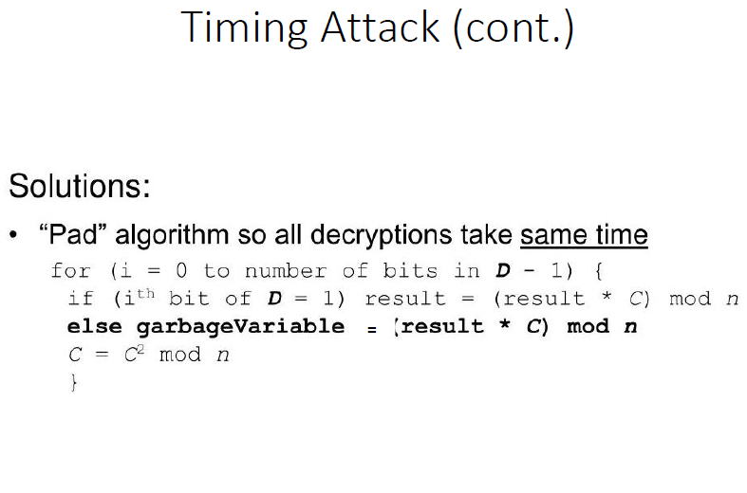

Slide 47
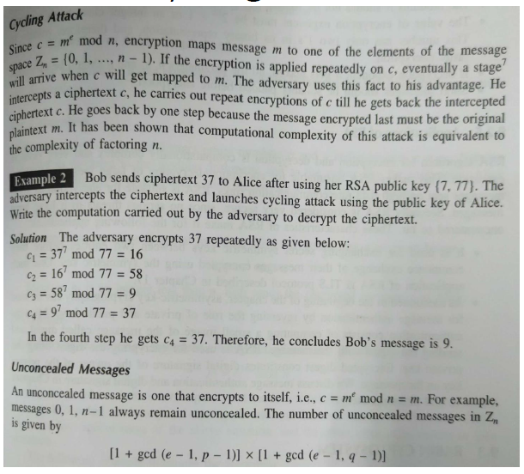
Cycling attack on RSA

Slide 48
RSA Cryptanalysis: Factoring Small Modulus (Insecure Key Lengths):
Problem: Suppose you have an RSA public key : {3,187}. You want to find the private key (d) and factor the modulus.
First, you need to find the prime factors of 187.
Attempt to factor 187:
11 x 17 = 187
Calculate ϕ(n) = (11-1)(17-1) = 160
Compute the private exponent (d) as the modular multiplicative inverse of 3 modulo 160. In this case, d = 107.
With this small modulus, RSA is insecure, and it's possible to factor the modulus and compute the private key efficiently. Real-world RSA implementations use much larger moduli (e.g., 2048 bits or more) to resist factorization attacks.

Slide 49
RSA Cryptanalysis: Factoring Small Modulus (Insecure Key Lengths)
Key = {3,33}
Factorize N: N=33 can be expressed as 33=3×11 So, p=3 and q=11
Calculate ϕ(N) = 2 * 10 =20
Public key e: Assume e=3 ‘e’ must satisfy 1<e<ϕ(N) and gcd⁡(e,ϕ(N))=1
Here, gcd⁡(3,20)=1 so e is valid.
Private key d : d is the modular multiplicative inverse of e modulo ϕ(N)
Solve e*d≡1 mod ϕ(N) 3*d≡1 mod 20
Using the extended Euclidean algorithm: d=7
Break RSA Using the factorization of N, the private key d can now be computed. With d, you can decrypt any ciphertext encrypted with the public key (N,e)
This is a toy example; real RSA uses large N (hundreds of digits) to make factorization infeasible.

Slide 50
RSA Cryptanalysis: Chosen Plaintext Attack (Theoretical)
An attacker can choose plaintexts to be encrypted and observe the resulting ciphertexts.
This scenario is highly simplified for illustration purposes:
Attacker chooses plaintexts P1 = 10 and P2 = 20.
Encrypted ciphertexts are : C1 = 37 and C2 = 77.
If the attacker knows value of public key e = 3 (a common choice), they can calculate potential private keys:
Private key d1: C1^{d1} ≡ P1 (mod n) ⇒ 37^{d1} ≡ 10 (mod n)
Private key d2: C2^{d2} ≡ P2 (mod n) ⇒ 77^{d2} ≡ 20 (mod n)
In reality, RSA encryption uses padding schemes that complicate this type of attack.
Cryptanalysis of real-world RSA encryption typically involves far more complex and resource-intensive techniques.

Slide 51
How to make RSA strong?
Use strong key lengths
Employ secure padding schemes
Regularly update cryptographic libraries and algorithms
Follow best practices in key management and protection
Actively explore post-quantum cryptographic alternatives.
Use padding in message text

Slide 52
Elliptic Curve Cryptography- ECC

Slide 53
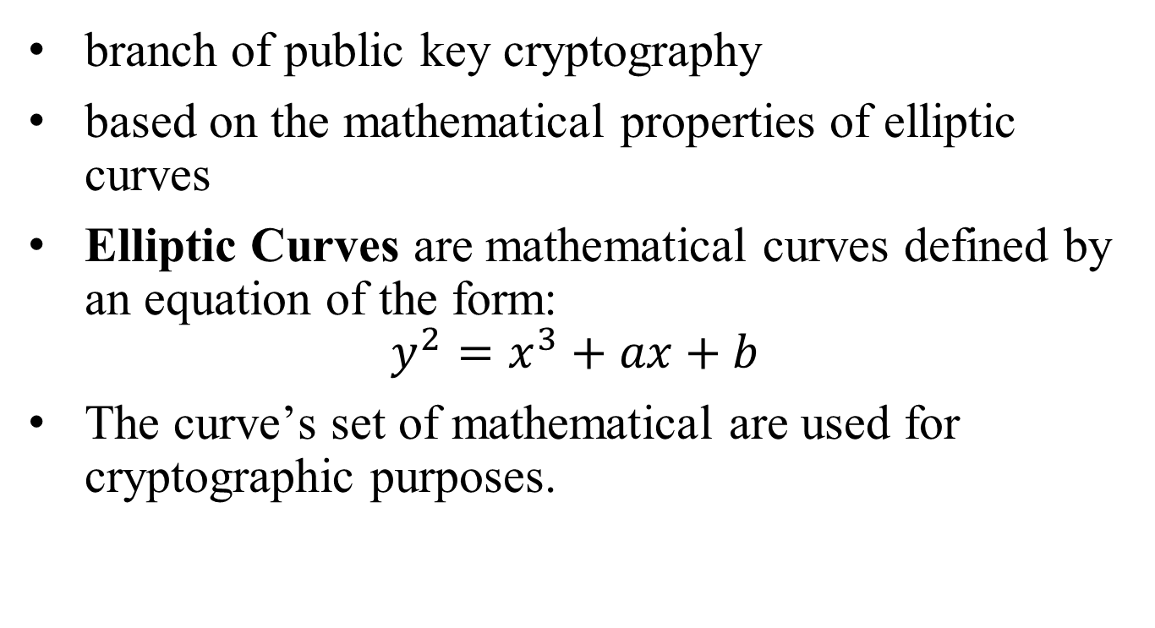
What is ECC
branch of public key cryptography
based on the mathematical properties of elliptic curves
Elliptic Curves are mathematical curves defined by an equation of the form:
$$y^{2}=x^{3}+ax+b$$
The curve’s set of mathematical are used for cryptographic purposes.

Slide 54
Why ECC?
Strong Security with Shorter Key Lengths:
strong security even with shorter key lengths compared to traditional RSA encryption.
For example, a 256-bit ECC key is as secure as a 3072-bit RSA key.
faster encryption and lower computational overhead.
Efficiency and Performance
ECC is computationally efficient and
requires fewer computational resources= processing power and memory
well-suited for cryptographic hardware implementations, where space and power constraints are critical factors
Lower Energy Consumption making it suitable for battery-powered devices and energy-efficient applications.
important for resource-constrained devices, such as mobile devices, IoT devices, and embedded systems
Compactness in Cryptographic Hardware
Faster Key Generation and Key Exchange:

Slide 55
Why ECC?
Lower Bandwidth and Storage Requirements:
ECC's shorter key lengths result in smaller digital certificates and cryptographic messages,
reducing the bandwidth and storage requirements
beneficial in web security (HTTPS) and email encryption.
Resilience Against Quantum Attacks:
Wide Industry Adoption in various industries and standards, e.g. TLS/SSL , digital signatures, and secure communications in IoT devices.
Forward Secrecy: i.e. even if an attacker compromises a private key at some point in the future, they cannot decrypt past communications, This is important for long-term security.
Security Provenance:
ECC's security is based on the mathematical complexity of elliptic curve problems.
It has been extensively analyzed and scrutinized by the cryptographic community.

Slide 56
Some Terms
ECC Equations
Points on curve
Public and private keys

Slide 57
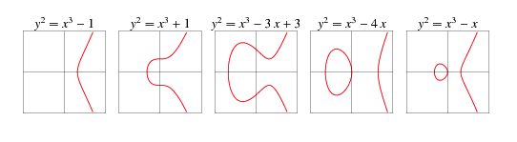
Elliptic curves
Elliptic curves are geometric objects
They don’t resemble ellipses in any way,
and they are not defined by ellipses either.
Yet, the word “elliptic” is really close to the word “ellipse”.
In an ellipse, two lines starting from the center of the ellipse to two different points on the circumference form an arc

Slide 58
Elliptic functions and Elliptic Curve
Elliptic functions have a limited set of possible solutions
These solutions (points) when plotted, form a curve - elliptic curves.
Definition: elliptic curves are the set of points that are obtained as a result of solving elliptic functions over a predefined space.

Slide 59
Elliptic functions and Elliptic Curve
Max number of points on curve are bounded by: p+1-2* sqrt(p)<=N<=(p+1)+2 *sqrt(p)
Horizontal symmetry: Any point on the curve can be reflected over the x axis and remain on the same curve.
A more interesting property is that any non-vertical line will intersect the curve in at most three places.

Slide 60
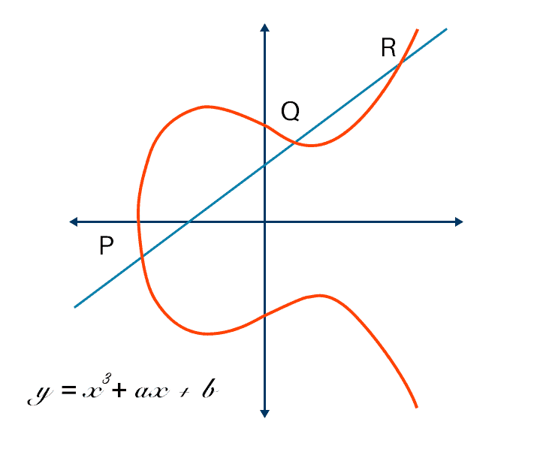
Why Elliptic curves are symmetric?
Y2 = x3+ax+b
⇒ y = sqrt(x3+ax+b)
y has +ve and -ve roots/values on graph (+-x)
when plotted, gives a symmetric curve along y=0

Slide 61
ECC types
ECC is defined as
EC over Zp, prime curve
EC over GF(2^m)

Slide 62
EC over Zp
Prime curve
Equation: y² mod p = (x³+ax+b) mod p
variables and coefficients are restricted to finite field
values range from (0 to p-1), values beyond p are taken as (value mod p)
curve is focused in only one quadrant from (0,0) through(p-1,p-1) with positive integers

Slide 63
Key computations involved in ECC
1. Scalar Multiplication:
multiply a point on the elliptic curve by a scalar (an integer).
E.g. if 2*p where p=p(x,y)
The result is another point on the curve.
Scalar multiplication is used in key generation, key exchange (ECDH), and digital signatures (ECDSA).
2. Point Addition and Subtraction:
allows combining and canceling points on the curve.
Diff formulae for p-q and p+q based on if p=q and p!=q
Point addition is used in scalar multiplication and key exchange operations to compute new points on the curve.

Slide 64
Key computations involved in ECC
3. Modular Arithmetic:
ECC operations are modular arithmetic in a finite field. All calculations are performed modulo a prime number p, which defines the field.
Modular addition, subtraction, multiplication, and inversion are used extensively in ECC.
4. Curve Parameter Computation:
ECC requires definition of an elliptic curve over a finite field with specific parameters a, b, and the prime modulus p.
These parameters are used to define the curve equation y^2 = x^3 + ax + b.
The parameters are chosen carefully to ensure security and efficiency.

Slide 65
Key computations involved in ECC
5. Key Pair Generation:
a random private key is chosen.
public key = scalar multiplication of the curve's base point by the private key.
The private key is typically a randomly generated integer, and the public key is a point on the curve.
6. Elliptic Curve Key Exchange (ECDH):
both parties compute shared secrets by performing scalar multiplications using their private keys and the other party's public key.
The shared secret is derived from the result of scalar multiplication.
7. Digital Signatures (ECDSA) (Not in syllabus)

Slide 66
Input pre-processing
Conversion of input data into ECC points→ out of scope of current honours course study

Slide 67
ECC arithmetic
Given Zp, compute all points on the curve
Compute -p, given a point p on EC
Addition over Zp
addition over GF(2m)

Slide 68
ECC examples
Given Elliptic curve : E₁₁(1,6), find matching points on curve in ECC over Zp
Solution:
Given ECC data: E₁₁(1,6)
i.e. p=11, a=1, b=6,
Zp ECC is defined as: y² mod p = (x³+ax+b) mod p
i.e. y² mod 11 = x³+x+6 mod 11
By ECC definition, range of points is= (0,p-1) 🡺 (0,10)
i.e. Values of x & y can be from 0 to 10
Problem: find values of x’,y’ such that LHS=RHS
Computed points also lie on the elliptic curve

Slide 69
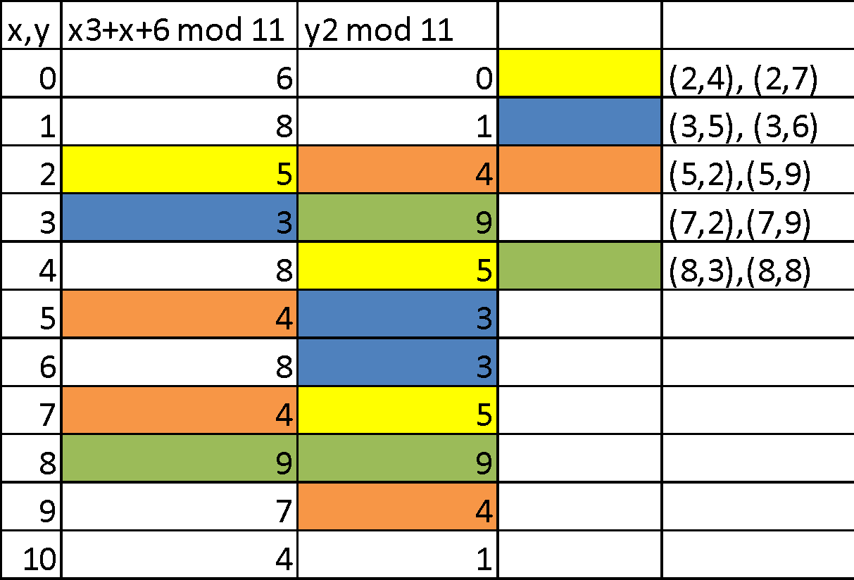
Matching points
(10,2), (10,9)

Slide 70
General process to find all points on the curve
Define the curve's equation: Specify the coefficients 'a' and 'b' and the finite field modulus 'p' to obtain the curve's equation.
Iterate through all 'x' values within the field (0 to p-1):
For each 'x' value, calculate the right-hand side of the curve equation, i.e., x^3 + ax + b (mod p).
Check if the result is a quadratic residue modulo 'p':
A quadratic residue is a value 'y^2 (mod p)' that has a square root modulo 'p.' You can use modular exponentiation to check if the result is a quadratic residue.
If 'y^2 (mod p)' is a quadratic residue, calculate the square root(s):
You'll have two possible values for 'y' for each 'x,' corresponding to the positive and negative square roots.
Create pairs of (x, y) points:
For each 'x' value with valid 'y' values, you have two points on the curve: (x, y) and (x, -y) if 'y' is not zero.
Store the valid points:
Store the pairs (x, y) and (x, -y) as the valid points on the curve.
the number of points on the curve is finite and depends on the specific curve parameters.

Slide 71
Problems
Given Elliptic curve : y² = x³ + 4x + 4 mod 7, find matching points on curve in ECC over Zp
Given Elliptic curve : y² = x³ + 4x + 4 mod 5, find matching points on curve in ECC over Zp

Slide 72
Compute -p, given a point p on EC
To compute the negation (-p) of a point 'p' on an elliptic curve (EC), you need to find the point with the same x-coordinate but the opposite y-coordinate. Here are the steps to compute -p:
Given a point 'p' on the elliptic curve, let's denote 'p' as (x, y).
Compute the negation (-p) by changing the sign of the y-coordinate:
If 'p' = (x, y), then (-p) = (x, -y).

Slide 73
Compute -p, given a point p on EC
Assume ECC equation : y² = x³ + 4x + 20 defined over finite field p=29.
Given Point P on the Curve: P = (x, y) = (4, 8)
To find -P, we simply negate the 'y' coordinate of P while keeping the 'x' coordinate unchanged:
Negation of P (-P): = (x, -y) = (4, -8)
So, the negation of point P on the elliptic curve is:-P = (4, -8)
Taking additive inverse
=(4,21)

Slide 74
For E23(1,1) and P=(13,7), find =-p
Solution:
Y²=x³+ax+b mod p i.e. = x³+x+1 mod 23
P=(13,7)
-p = (x,-y)
= (13,-7)
taking additive inverse of -7,
-p = (13, 16)

Slide 75
Addition over Zp
It’s a fundamental operation used in various cryptographic protocols, including key exchange and digital signatures.
The addition of points in ECC follows specific rules that are defined by the curve's equation and the finite field modulus 'p.'

Slide 76
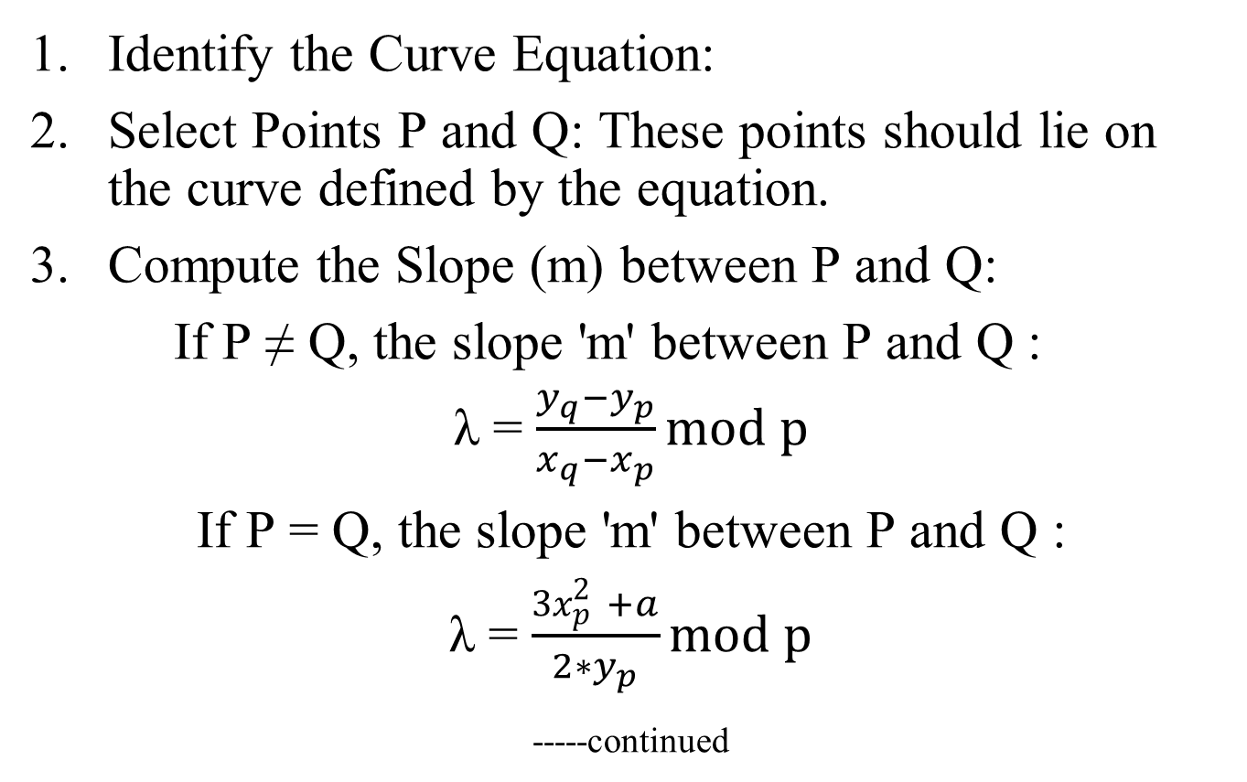
Addition over Zp
Identify the Curve Equation:
Select Points P and Q: These points should lie on the curve defined by the equation.
Compute the Slope (m) between P and Q:
If P ≠ Q, the slope 'm' between P and Q :
λ = $\frac{y_{q}−y_{p}}{x_{q}−x_{p}}mod p$
If P = Q, the slope 'm' between P and Q :
λ = $\frac{{3x}_{p}^{2} +a}{2∗y_{p}}mod p$
_{-----continued}

Slide 77
Addition over Zp
4. Calculate the Sum R:
x-coordinate : x_{r} = λ² - x_{p} – x_{q} mod p
y-coordinate y_{r} = λ * (x_{p} - x_{r}) – y_{p} mod p
Ensure that the x and y coordinates of R are reduced modulo 'p' to stay within the finite field.
Ensure you calculate modular inverses appropriately if needed.
The point R(xR, yR) is the sum of points P and Q on the elliptic curve.

Slide 78
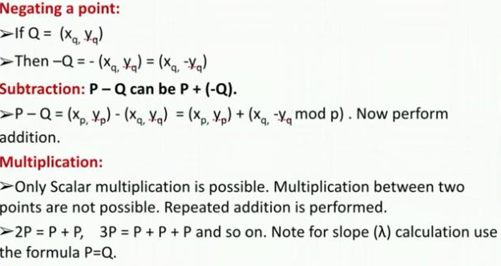

Slide 79
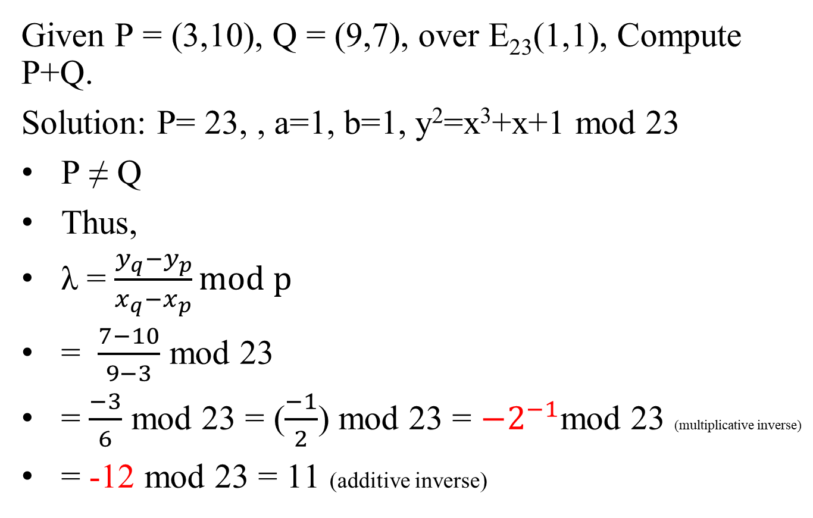
Given P = (3,10), Q = (9,7), over E₂₃(1,1), Compute P+Q.
Solution: P= 23, , a=1, b=1, y²=x³+x+1 mod 23
P ≠ Q
Thus,
λ = $\frac{y_{q}−y_{p}}{x_{q}−x_{p}}mod p$
= $\frac{7−10}{9−3}$ mod 23
= $\frac{−3}{6}$ mod 23 = ($\frac{−1}{2}$) mod 23 = $−2^{−1}$mod 23 (multiplicative inverse)
= -12 mod 23 = 11 (additive inverse)

Slide 80
x-coordinate : x_{r} = λ² - x_{p} – x_{q} mod p
y-coordinate y_{r} = (λ * (x_{p} - x_{r}) – y_{p)} mod p
x_{r} = 11² - 3 – 9 = 121 - 12 mod 23 = 109 mod 23 = 17
y_{r} = (11 * (3 - 17 ) – 10) mod 23 = -154-10 mod 23
= -164 mod 23 = 20 mod 23 = 20
Thus, P(3,10) + Q(9,7) = R(17,23)

Slide 81
Given P = (3,10), Q = (9,7), over E₂₃(1,1), Compute 2P.
Given P = (3,10), Q = (9,7), over E₂₃(1,1), Compute 3P. (Hint: 3P= P+2P)
Given P = (3,10), Q = (9,7), over E23(1,1) Compute P+Q

Slide 82
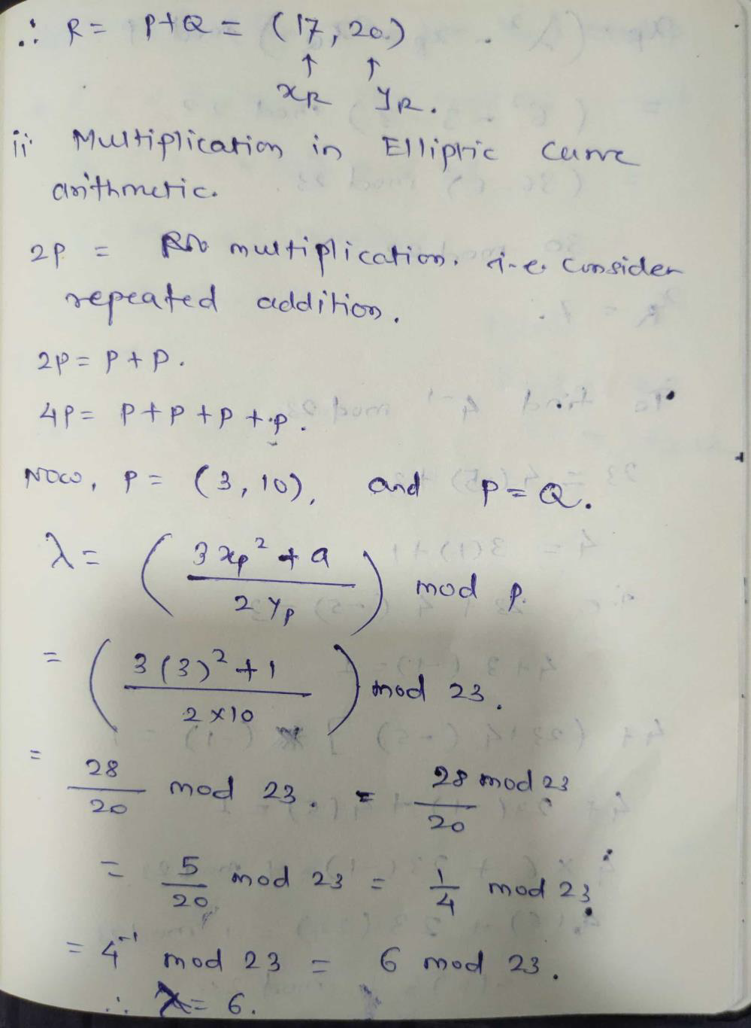
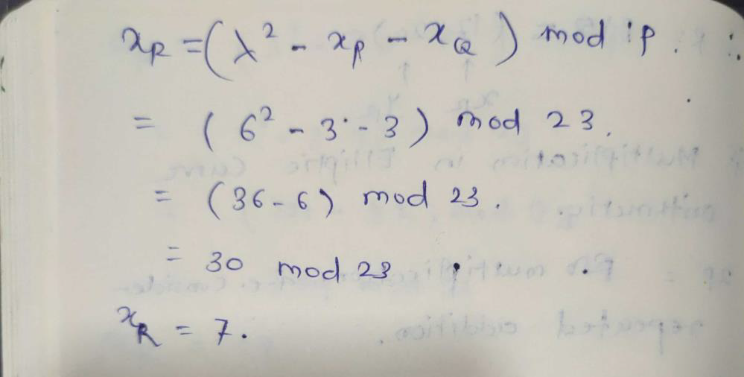
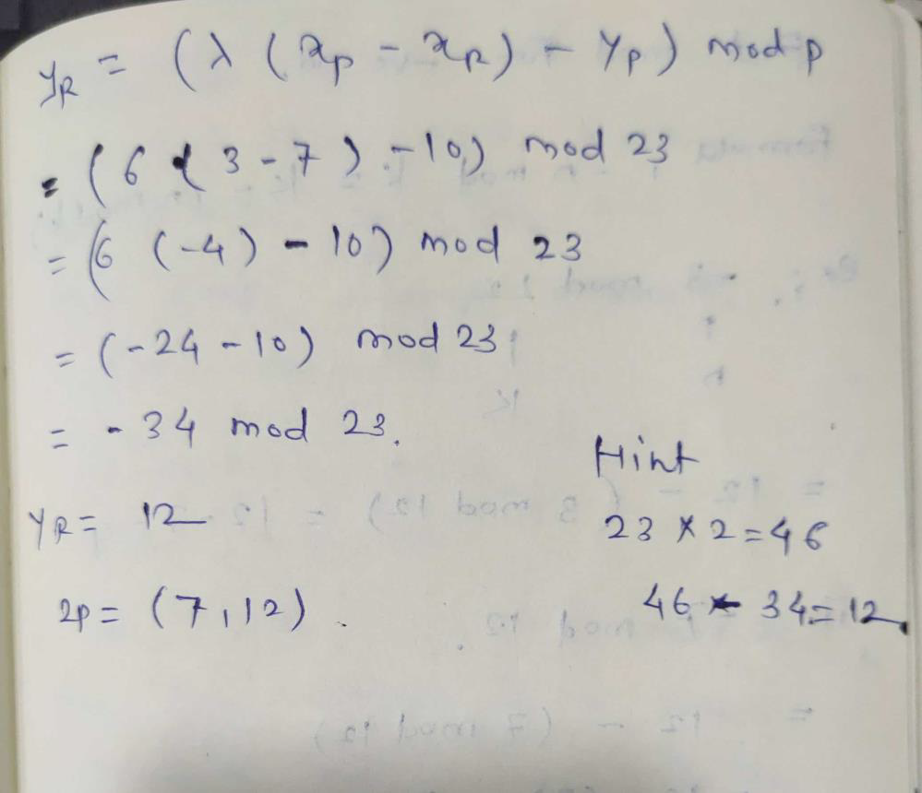

Slide 83
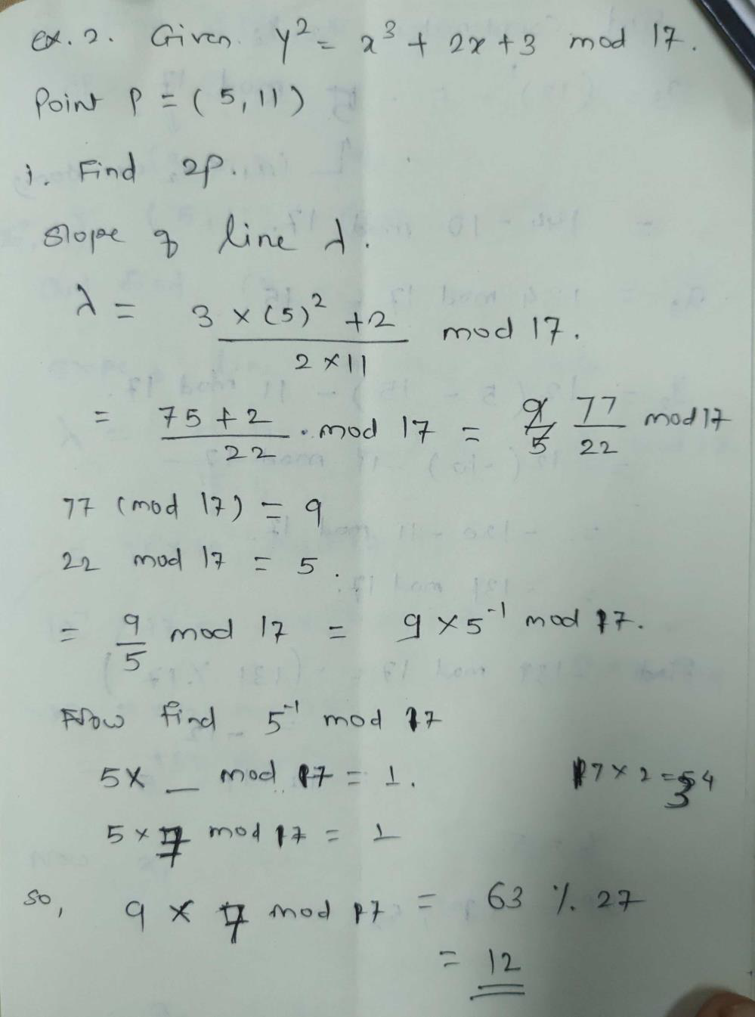
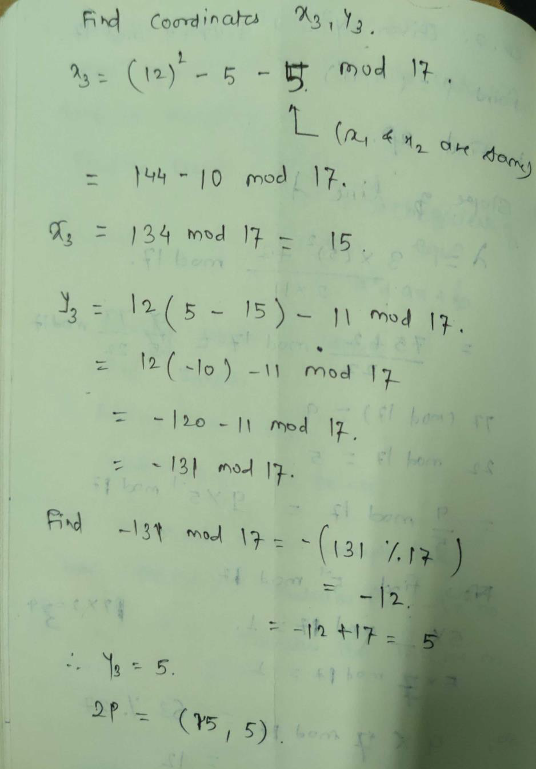

Slide 84
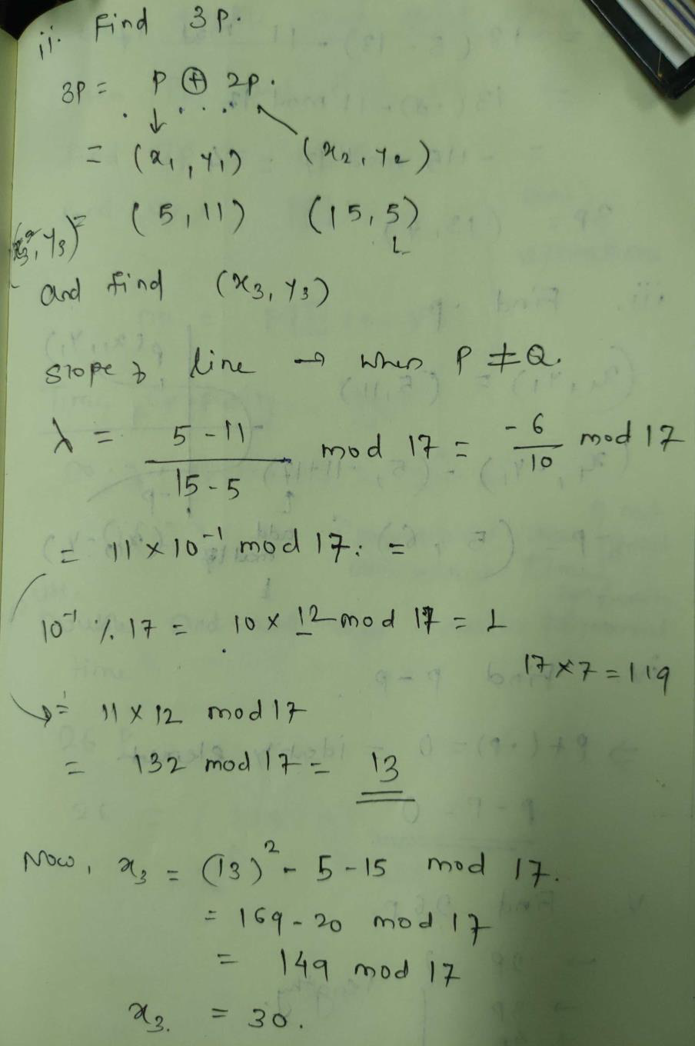
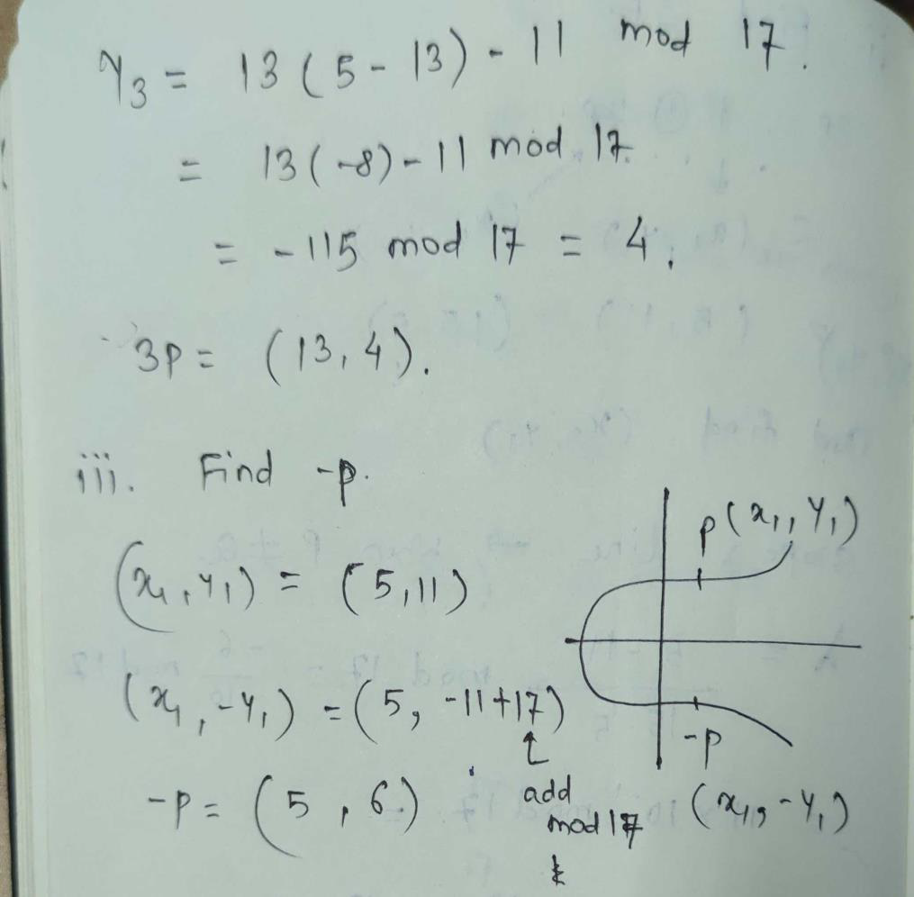

Slide 85
Elliptic Curve Cryptography
The private keys in the ECC are integers (in the range of the curve's field size, typically 256-bit integers).
Example of 256-bit ECC private key (hex encoded, 32 bytes, 64 hex digits) is: 0x51897b64e85c3f714bba707e867914295a1377a7463a9dae8ea6a8b914246319.
The public keys are points on elliptic curve {x, y}
Example of ECC public key 0x02f54ba86dc1ccb5bed0224d23f01ed87e4a443c47fc690d7797a13d41d2340e1a.

Slide 86
Consequently, in ECC we have:
Еlliptic curve (EC) over finite field 𝔽p
G = generator point (fixed constant, a base point on the EC)
private key =integer
public key =point

Slide 87
Deffie-Hellman Key exchange using ECC- ECDH
ECC key exchange – similar to DH Key exchange
Global public elements
• Eq(a,b) - Elliptic curve parameters – a,b and q – prime no. or integer of the form 2m.
• G – point on the elliptic curve

Slide 88
ECDH
User A key generation
• Select private key nA, such that nA < n
• Calculate public key PA, PA = nA * G
• User B key generation
• Select private key nB, nB < n
• Calculate public key PB, PB = nB * G
Calculation of secret key by User A, K = nA * PB
• Calculation of secret key by User B, K = nB * PA

Slide 89
ECDH
we compute some q= k*p where q,p ∈ Ep(a,b)
Given k & p its easy to compute q
but, knowing p & q, it's difficult to compute k ⇒ discrete logarithmic problem for EC
could be little easy with availability of a trapdoor
in reality, k is very large making brute force infeasible to achieve

Slide 90
Example ECDH
Assume Elliptic Curve Parameters:
Elliptic Curve Equation: y² = x³ + 2x + 2` (over a prime field)
Prime Modulus (p): 17
Base Point (G): (15, 13)
Let Alice's Private Key (a): 7
Let Bob's Private Key (b): 5

Slide 91
Example ECDH… contd
Alice's Key Generation:
1. Alice selects private key 'a' (a random integer): a = 7.
2. Alice computes her public key 'QA' by scalar multiplication: QA = a * G.
QA = 7 * (15, 13) = (7, 7)
Bob's Key Generation:
1.Bob selects private key 'b'(a random integer): b = 5.
2. Bob computes his public key 'QB' by scalar multiplication: QB = b * G.
QB = 5 * (15, 13) = (3, 13)

Slide 92
Example ECDH… contd
Key Exchange:
1. Alice sends her public key 'QA' to Bob.
2. Bob sends his public key 'QB' to Alice.
Shared Secret Calculation:
1. Alice computes the shared secret 'S' using Bob's public key 'QB' and her private key 'a':
S = a * QB = 7 * (3, 13) = (10, 0)
2. Bob computes the shared secret 'S' using Alice's public key 'QA' and his private key 'b':
S = b * QA = 5 * (7, 7) = (10, 0)
Now, both Alice and Bob have computed the same shared secret 'S' as (10, 0).

Slide 93
Example 2
Elliptic Curve Equation: y^2 = x^3 + 7
Prime Modulus (Field Size): p = 23
Base Point (a known point on the curve): `G = (3, 10)`
Private Key for Party A: `dA = 6`
Private Key for Party B: `dB = 15`

Slide 94
Example 2.. contd
Key Exchange Steps:
1. Party A Computes Public Key:
QA = dA * G = 6 * (3, 10) = (18, 6)
2. Party B Computes Public Key:
QB = dB * G = 15 * (3, 10) = (7, 12)
3. Exchange Public Keys:
Party A sends QA = (18, 6) to Party B.
Party B sends QB = (7, 12) to Party A.
4. Shared Secret Calculation:
SA = dB * QA = 15 * (18, 6) = (22, 14)
SB = dA * QB = 6 * (7, 12) = (22, 14)

Slide 95
Discrete logarithmic problem in ECC
Parameters:
n is a point on the elliptic curve.
k is an integer (the private key or scalar).
p is a fixed point on the elliptic curve (typically called the base point).
Objective:
find the integer k given the base point p and the result n of multiplying p by k.
In mathematical terms, it's solving for k in the equation: n = k * p.

Slide 96
Discrete logarithmic problem in ECC
Difficulty:
The security of ECC relies on the computational difficulty of solving this equation for k.
The size of the elliptic curve group and the difficulty of solving the discrete logarithm problem depend on the size of the underlying finite field.
Security:
The security of ECC is based on the belief that there is no efficient algorithm to compute k from n and p, except through exhaustive search
which is computationally infeasible for large enough key sizes.
For example, if you have a public key n and a base point p, an attacker should not be able to efficiently determine the private key k used to generate that public key.
ECC's security is built on this presumed computational hardness of the discrete logarithm problem.s

Slide 97
ECC encryption
Let the message be M
encode message M into a point on elliptic curve: Pm
• For encryption: choose a random positive integer K.
• The cipher point will be:
Cm = {KG, Pm + KPB}
• This point will be sent to receiver.

Slide 98
For Decryption:
multiply x-coordinate with receiver’s secret key : KG * nB
• Then subtract from coordinate of cipher point;
• Pm + KPB – ( K*G * nB)
• We know that, PB = nB * G
So substitute in above equation and we get,
• Pm + K*PB – K*PB
= Pm
So, receiver gets the same point.

Slide 99
Limitations and challenges of ECC
Complexity of Implementation:
implementation can be more complex.
complexity can lead to implementation errors, which may introduce vulnerabilities if not handled properly.
Performance Variability:
performance can vary based on the choice of elliptic curve parameters, hardware, and software implementations.
Some curves may be more efficient than others,
Standardization and Interoperability:
ECC standards and implementations have not been as widely adopted as RSA and other older cryptographic algorithms.
Achieving interoperability between different ECC implementations and platforms can be challenging.

Slide 100
Limitations and challenges of ECC
Patent and Licensing Issues:
Some ECC algorithms and curve choices were initially patented, which raised concerns about licensing and intellectual property rights.
However, many of these patents have since expired or been made available for open use.
Random Number Generation:
ECC relies on the generation of high-quality random numbers for key pair generation and other operations. Inadequate random number generation can weaken the security of ECC.

Slide 101
Limitations and challenges of ECC
Quantum Threats:
ECC is not entirely immune to Quantum Threats
Quantum computers with sufficient qubits and processing power could potentially threaten ECC-based encryption.
Key Management:
Managing ECC keys can be challenging, especially in large-scale deployments.
Key distribution, storage, and revocation can present difficulties similar to those in other public key infrastructures.
Side-Channel Attacks:
ECC implementations can be vulnerable to side-channel attacks, such as timing and power analysis attacks, if not carefully protected against these threats.

Slide 102
Limitations and challenges of ECC
Misuse of Weak Curves:
The security relies heavily on the choice of elliptic curves.
Using weak or non-standard curves can introduce vulnerabilities.
It is essential to use well-established and standardized curves with known security properties.
Lack of Post-Quantum Security:
While ECC is more resilient to quantum attacks than some other cryptographic techniques, it is still a topic of ongoing research and debate.
The long-term security of ECC in a post-quantum world remains uncertain.

Slide 103
Disadvantages of ECC
Complicated and tricky to implement securely, mainly the standard curves.
Standards aren't state-of-the-art, particularly ECDSA, which is a hack compared to Schnorr signatures.
Newer algorithms could theoretically have unknown weaknesses. Binary curves are slightly scary.
Signing with a broken or compromised random number generator compromises the key.
It still has some patent problems, especially for binary curves. It might be costly...
Public key operations (e.g., signature verification, as opposed to signature generation) are slow with ECC.

Slide 104
Applications of ECC
Secure Communication Protocols:
TLS/SSL: ECC is used in the Transport Layer Security (TLS) and Secure Sockets Layer (SSL) protocols to secure data transmission over the internet, including secure web browsing (HTTPS).
Digital Signatures:
ECDSA (Elliptic Curve Digital Signature Algorithm): ECC is employed for digital signatures, ensuring message authenticity and integrity in various applications, including email, software updates, and document verification.

Slide 105
Applications of ECC
Key Exchange:
ECDH (Elliptic Curve Diffie-Hellman): ECC is utilized in ECDH for secure key exchange between parties over insecure communication channels, facilitating secure symmetric key establishment for encryption.
Cryptographic Libraries:
ECC is a fundamental component of many cryptographic libraries and frameworks, making it accessible to developers for building secure applications.
IoT Security:
ECC's efficiency and small key sizes make it suitable for securing communication in resource-constrained Internet of Things (IoT) devices, ensuring data privacy and integrity in IoT applications.

Slide 106
Applications of ECC
Mobile Devices:
ECC is used in mobile devices, such as smartphones, to secure data transmission, app authentication, and device encryption. Its efficiency is especially beneficial in mobile environments.
Wireless Communication:
ECC is employed in wireless communication standards like Bluetooth and Wi-Fi (WPA3) to secure data exchange between devices and networks.
Digital Rights Management (DRM):
ECC can be used in DRM systems to protect copyrighted content and ensure that only authorized users can access and decrypt protected content.

Slide 107
Applications of ECC
Secure Shell (SSH):
ECC can be used in SSH for secure remote login and data transfer, providing a secure alternative to traditional password-based authentication.
Smart Cards and Secure Tokens:
ECC is used in smart cards and hardware security tokens for secure authentication, access control, and digital signatures, providing strong security in a compact form factor.
Blockchain and Cryptocurrencies:
ECC plays a critical role in many blockchain platforms and cryptocurrencies, such as Bitcoin, for generating public and private keys, signing transactions, and securing the blockchain ledger.

Slide 108
Applications of ECC
Secure Messaging and Chat Applications:
ECC is used in secure messaging and chat applications to ensure end-to-end encryption and message authenticity, protecting user privacy.
Government and Military Applications:
ECC is used in government and military systems for secure communications, classified information protection, and digital signatures in various security-critical applications.
Cloud Computing:
ECC can be used to secure data transmission and authentication in cloud computing environments, ensuring data privacy and integrity in the cloud.
Payment Systems and Financial Services:
ECC is employed in payment systems, digital wallets, and financial services for securing online transactions and protecting sensitive financial data.

Slide 109
Design a system for secure communication

